Slide 1


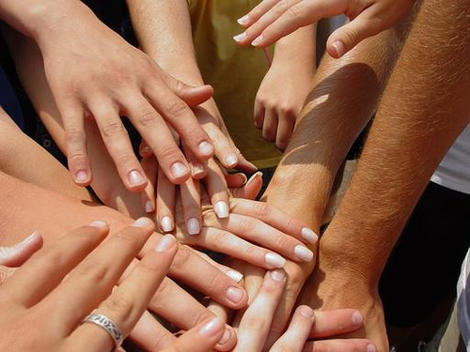

Start Your Own Blog
The Culture of Knowledge Sharing and Collaboration
SoftUni Team
Technical Trainers
Software University
http://softuni.bg

Slide 2



The Culture of Knowledge Sharing and Collaboration
Open Education, Knowledge Sharing, Team Working, Helping Others

Slide 3

Open Knowledge and Education
What is "open knowledge sharing"?
A modern concept in education and society
Knowledge becomes open to the world
High-quality training becomes free
Idea broadly supported by:
World's top universities like Harvard, MIT, Berkeley, Stanford, Oxford, Cambridge, …
Online free training MOOC sites:
Khan Academy, Coursera, Udacity, edX, Ucha.se, Codecademy, Code.org, Code School, Telerik Academy, SoftUni, …

Slide 4

The World Becomes Open!
Open Education
http://en.wikipedia.org/wiki/Open_education
Citizen Science (Open Science)
http://en.wikipedia.org/wiki/Citizen_science
Open Knowledge Foundation
http://okfn.org
Open Knowledge Conference
http://okcon.org
Open Government
http://www.opengovpartnership.org

Slide 5
The Culture of Helping Others
“if one lights a fire for others, one will brighten one’s own way” ~Buddha
How it works?
Initially you get help from the others
E.g. from the Software University
You start a good job, have a good life standard, good incomes, etc.
Give back 10% of what you have to help others
E.g. help by volunteer work, by charity or by sharing your knowledge and skills

Slide 6


Start Your Own Blog
WordPress, Blogger

Slide 7
WordPress

Slide 8
WordPress
What is WordPress?
The most popular online publishing platform, currently powering more than 20% of the web.
Offers free hosting at blogname.wordpress.com
You can find it at https://wordpress.com

Slide 9
WordPress
Live Demo

Slide 10

Blogger

Slide 11
Blogger
What is Blogger?
Older platform with lesser functionality.
Owned by Google
Offers free hosting at blogname.blogspot.com
You can find it at https://www.blogger.com

Slide 12
Blogger
Live Demo

Slide 13
Good Practices
What can you take from the others

Slide 14
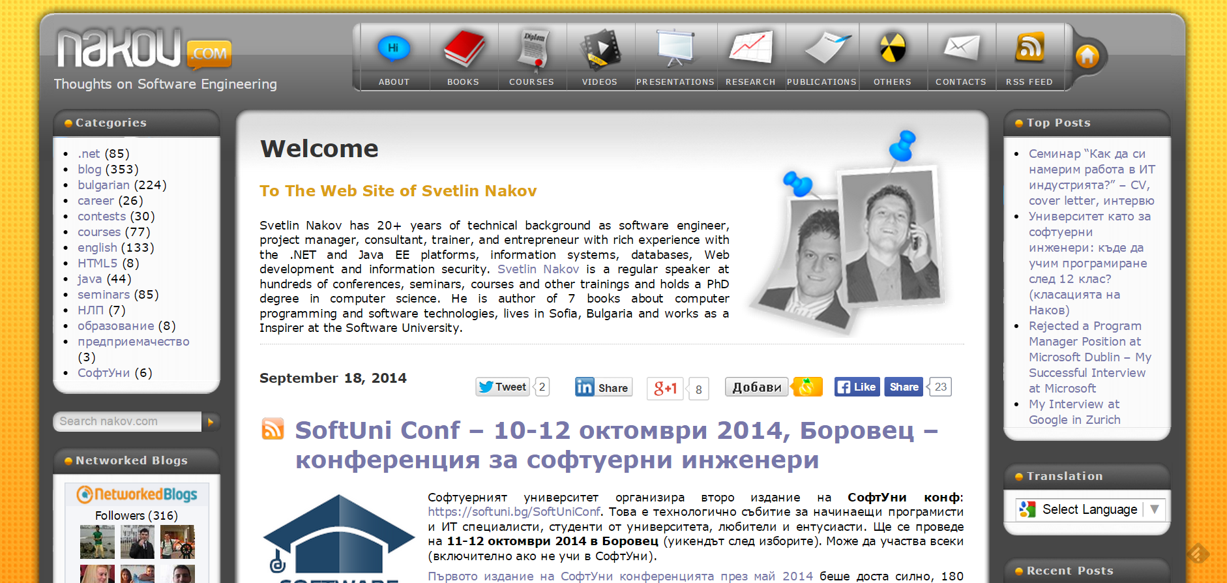
nakov.com

Slide 15
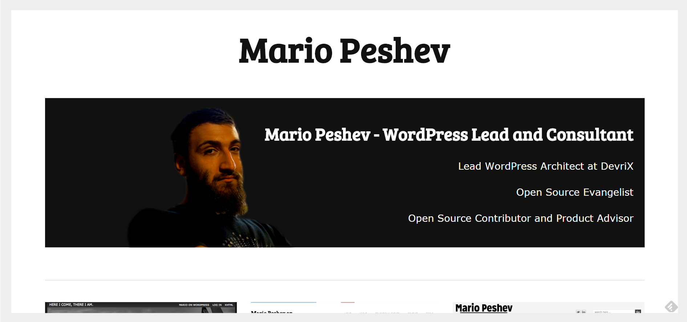
peshev.net

Slide 16
Others
http://gatakka.eu/
http://vgeorgiev.org/
http://angeru.softuni-friends.org/
http://www.scotthyoung.com/blog/
http://www.fluentin3months.com/

Slide 17









Start Your Own Blog
https://softuni.bg/courses/teamwork-and-personal-skills/

Slide 18
License
This course (slides, examples, demos, videos, homework, etc.) is licensed under the "Creative Commons Attribution-NonCommercial-ShareAlike 4.0 International" license
Attribution: this work may contain portions from
"Knowledge Sharing and Team Working" course by Telerik Academy under CC-BY-NC-SA license

Slide 19





Free Trainings @ Software University
Software University Foundation – softuni.org
Software University – High-Quality Education, Profession and Job for Software Developers
softuni.bg
Software University @ Facebook
facebook.com/SoftwareUniversity
Software University @ YouTube
youtube.com/SoftwareUniversity
Software University Forums – forum.softuni.bg

